Slide 1

UNIVERSITY INSTITUTE OF SCIENCES
Academic Unit V
Bachelor of Engineering
(Computer Science & Engineering)
Biology For Engineers
23SZT148
Signal conditioners
Preamplifiers
Differential Amplifier
Isolation Amplifier
DISCOVER . LEARN . EMPOWER

Slide 2

SYLLABUS
Unit-3 | Bio Medical Instrumentation | Contact Hours: 15
Chapter 1 Electrical stimulus and biophysical activity Chapter 2 Biomedical recording system Chapter 3 Tissue Engineering | Electrical stimulus and biophysical activity: Patient, electrical shock and hazards, leakage current, Electrical activity of heart (ECG), Electrical activity of brain (EEG), Electrorentinogram (ERG), Electro-occologram (EOG), Electromyogram (EMG). Biomedical recording systems: Basic Recording system, General consideration for signal conditioners Preamplifiers, Differential Amplifier, Isolation Amplifier, Vectorcardiograph, Phonocardiograph, Other biomedical records, Patient isolation, and accident prevention. Tissue Engineering: Recombinant DNA technology, Stem cell biology & Tissue Engineering.

Slide 3
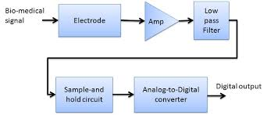
Course Outcome
CO Number | Title | Level
CO1 | Identify the biological concepts from an engineering perspective. | Remember
CO2 | Development of artificial systems mimicking human action. | Understand
CO3 | Explain the basic of genetics that helps to identify and formulate problems | Understand
CO4 | Apply knowledge of measurement system, biomedical recording system and biosensors to excel in areas such as entrepreneurship, medicine, government, and education. | Understand
CO5 | Integrate biological principles for developing next generation technologies
Will be covered in this lecture
https://images.app.goo.gl/5obqqxo93P2UBmdU6

Slide 4
Basic Recording System
Signal conditioners
Preamplifiers
Differential Amplifier
Isolation Amplifier

Slide 5
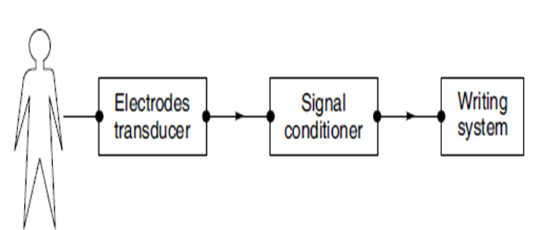
Biomedical Recording Systems
Recorders provide permanent visual record of an applied electrical signal.
The most basic electronic recording system consists of 3 important components:
Electrodes/Transducer
Signal conditioner
Writing system
The signal conditioner converts the output of the electrode/transducer into an electrical quantity suitable for operating the writing system.
The writing system provides a visible graphic representation of the quantity of the physiological variable of interest.
The electrode picks up the bioelectric potentials whereas the transducer converts the physiological signal to be measured into a usable electrical output.

Slide 6
What is Signal Conditioning? Role in instrumentation
Analog signals need to be correctly "prepared" before they can be converted into digital form for further processing.
For example, thermocouple signals have very small voltage levels that must be amplified before they can be digitized.
Signal conditioning is one of the fundamental building blocks of modern data acquisition.
Signal conditioning is an electronic circuit that manipulates a signal in a way that prepares it for the next stage of processing.
Many data acquisition applications involve environmental or mechanical measurement from sensors, such as temperature and vibration. These sensors require signal conditioning before a data acquisition device can effectively and accurately measure the signal.
Other sensors, such as resistance temperature detectors (RTDs), accelerometers, and strain gauges require excitation to operate.
All of these preparation technologies are forms of signal conditioning.
The basic purpose of a data acquisition system is to make physical measurements.

Slide 7
Role in instrumentation
Amplification:
Role: Biomedical signals are often weak, and amplification is necessary to increase their strength for proper analysis.
Example: Electrocardiogram (ECG) signals generated by the heart are usually small in amplitude and require amplification before further processing.
Filtering:
Role: Signal conditioners include filters to eliminate unwanted noise and interference, ensuring that only the relevant frequency components of the signal are retained.
Example: In electroencephalogram (EEG) recordings, filtering helps remove artifacts and unwanted signals from muscle activity or environmental interference.

Slide 8
3. Isolation:
Role: Isolation is essential for patient safety and to prevent electrical interference between different parts of a biomedical system.
Example: Isolation is often used in applications where the patient is electrically connected to the instrumentation to prevent the flow of current between the patient and the measurement system.
4. Analog-to-Digital Conversion (ADC):
Role: Many biomedical signals are analog in nature, and digitization is required for further processing using digital signal processing techniques.
Example: The ADC in a signal conditioner converts analog signals, such as the output of a blood pressure sensor, into digital format for computerized analysis.

Slide 9
4. Temperature Compensation:
Role: Some biomedical sensors are sensitive to temperature variations, and signal conditioners may include compensation mechanisms to account for temperature changes.
Example: Temperature compensation is crucial in applications like glucose monitoring, where the sensor's response may vary with temperature.
5. Linearization:
Role: Some sensors have nonlinear characteristics, and linearization is performed to make the relationship between the physical quantity and the electrical output more predictable.
Example: In temperature measurements, thermocouples may exhibit nonlinear behavior, and signal conditioners can linearize the output to simplify interpretation.
6. Signal Rectification and Integration:
Role: Depending on the type of analysis needed, signal conditioners may include circuits for rectifying or integrating the signal.
Example: In electromyography (EMG), signal rectification may be applied to convert the AC signal representing muscle activity into a DC signal for analysis.

Slide 10
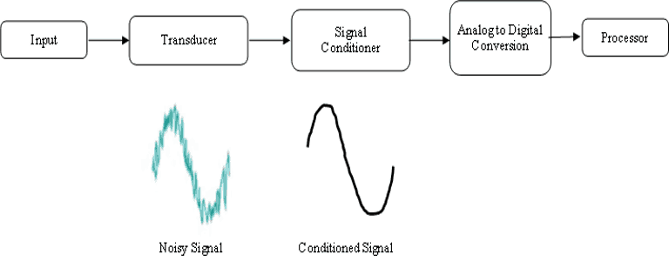

Slide 11
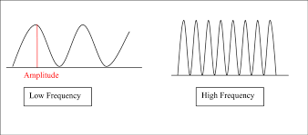
Biological Amplifiers
Generally, biological/bioelectric signals have low amplitude and low frequency.
Therefore, to increase the amplitude level of biosignals amplifiers are designed.
The outputs from these amplifiers are used for further analysis and they appear as ECG, EMG, or any bioelectric waveforms.
LESS FREQUENCY, LESS AMPLITUDE
HIGH FREQUENCY, HIGH AMPLITUDE

Slide 12
Isolation Amplifier- Purpose
Isolation amplifiers allow measurement of small signals in the presence of a high common mode voltage by providing electrical isolation and an electrical safety barrier.
These amplifiers are also used for amplifying low-level signals in multi-channel applications.
An isolation amplifier provides isolation of one part of a circuit from another, so that power is not used, drawn, or wasted in a part of the circuit.

Slide 13
Biomedical Records
Vectorcardiograph
Phonocardiograph
Ballistocardiograph
Pulse Oximeter

Slide 14
Vectorcardiograph and applications
Vectorcardiography (VCG) is a method of developing two-dimensional (2D) images of electrical activity of heart by obtaining ECG along three axis.
Vectorcardiograph is an instrument that record the magnitude and direction of the electrical forces that are generated by the heart by means of a continuous series of vectors that form curving lines around a central point.
The method was developed by E. Frank in the mid 1950s.
Since the human body is a three-dimensional structure, the basic idea is to construct 3 orthogonal leads containing all the electric information scanned in three mutually orthogonal axes (vertical, transversal, and sagittal).
Display is know as vector cardiogram.
Notes:
Sagittal: of or in a plane parallel to the sagittal suture, especially that dividing the body into left and right halves.

Slide 15
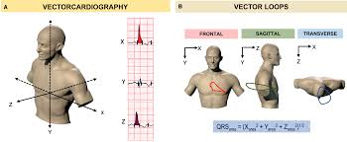

Slide 16
Vectorcardiography (VCG) is an investigation method that was previously compared to ECG several times and was evaluated as a useful investigation method.
VCG provides better sensitivity, for example for the detection of myocardial infarction and hypertrophy.
A Polaroid camera photographs, the oscilloscope screen to provide a permanent record.
It is the recording of the moment-to-moment electromotive forces of the heart on a plane of the body surface delineated as a vector function of time.
With the modern computer facilities, the vectorcardiography may be clinically used in an extensive manner, even though it is not widely used clinically now.
It achieved a higher sensitivity for the detection of hypertrophy as well as ischaemic heart disease.
The vector cardiogram appears as loops in each plane.
There are three loops corresponding to P, QRS and T waves. Among this the QRS complex loop is dominating one.
However, in clinical practice, measurement of VCG is not usually used because it requires additional electrodes placed on the patient’s body.
Notes:
Ischemic heart disease: It's the term given to heart problems caused by narrowed heart arteries.

Slide 17
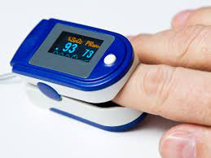
Pulse Oximeter
Pulse oximetry is a test that measures the oxygen saturation level of your blood.
It uses light beams to estimate the oxygen saturation of the blood and the pulse rate.
It can rapidly detect even small changes in oxygen levels.
The pulse oximeter is a small, clip-like device that is usually placed on a fingertip.
These levels show how efficiently blood is carrying oxygen to the extremities furthest from your heart, including your arms and legs.
Oxygen saturation gives information about the amount of oxygen carried in the blood.
O2 saturation- how much hemoglobin is currently bound to oxygen

Slide 18
The pulse oximeter can estimate the amount of oxygen in the blood without having to draw a blood sample.
The principle of operation of pulse oximeter is based on the concept that the oxygen saturation determinations can be made using two wavelengths.
The instrument consists of a pair of small LEDs facing a photodiode (photosensor).
The light from the LEDs, passes through a translucent part of the patient’s body generally forefinger.
These two wavelengths assume two absorbers namely: Oxyhaemoglobin (HbO₂) and Haemoglobin (Hb).
One of these two LEDs transmits infrared light at a wavelength of approximately 940 nm while the other transmitting light at approximately 660 nm.

Slide 19
The pulse oximeter operates on the principle of absorption of light by the solutes in a solution.
The Beer-Lambert law states that the amount of light absorbed by a solute is proportional to the concentration of the solute and the distance the light is transmitted through the solution.
The absorption of these select wavelengths of light through living tissues is significantly different for oxygenated haemoglobin (HbO₂) and reduced haemoglobin (Hb).
The absorption of these selected wavelengths of light passing through living tissue is measured with a photodiode/photosensor.
Oxygen saturation values are between 95% and 100% for most healthy individuals.

Slide 20
REFERENCES
John G Webster, “Medical Instrumentation – Application and Design”, 4th ed., John Wiley and Sons, 2007.
Leslie Cromwell, Fred. J. Weibell, Erich. A. Pfeiffer, “Biomedical Instrumentation & Measurements, 2nd ed., Pearson Education., 2001.
Basmajian, “Biofeedback- Principles and practice for clinicians.”
Susan o Sullivan, “Physical rehabilitation”
Ryaby J.T. (2005) Biophysical Stimulation Using Electrical, Electromagnetic, and Ultrasonic Fields. In: Lieberman J.R., Friedlaender G.E. (eds) Bone Regeneration and Repair. Humana Press. https://doi.org/10.1385/1-59259-863-3:291
Leshie Cromwell, Fred.J. Weibell and Erich.A.Pfeiffer. 2003. Biomedical instrumentation and measurements. 2nd edition, PHI.
John G. Webster 1998. Medical Instrumentation: Applications and Design, 3rd edition, Jon Wiley and Sons, New York.
Jon Cooper, , 2004. “Biosensors A Practical Approach” Bellwether Books.

Slide 21
THANK YOU

